Slide 1
Project 2: Public Private University
Machine Learning: K Means Clustering
Project build under the guidance of Professor Nitesh Karmakar
Machine Learning Mentor(KSI)

Slide 2
K means Clustering
K-Means Clustering is an unsupervised machine learning algorithm.
In contrast to traditional supervised machine learning algorithms, K-Means attempts to classify data without having first been trained with labeled data.
Once the algorithm has been run and the groups are defined, any new data can be easily assigned to the most relevant group.

Slide 3
Dataset
The dataset is a CSV(comma separated value) having 777 rows × 18 columns

Slide 4
Attributes and its significance
Private: A factor with levels No and Yes indicating private or public university
Apps: Number of applications received
Accept: Number of applications accepted
Enroll: Number of new students enrolled
Top10perc: Percentage new students from top 10% of high school class
Top25perc: Percentage of new students from top 25% of their high school class
F.Undergrad: Number of full-time undergraduates
P.Undergrad: Number of part-time undergraduates
Outstate: Out-of-state tuition

Slide 5
Attributes and its significance
Room.Board: Room and board costs
Books: Estimated book costs
Personal: Estimated personal spending
PhD: Percentage of faculty with PhDs
Terminal: Percentage of faculty with a terminal degree (PhD/JD/MD/MBA/etc)
S.F.Ratio: Student/faculty ratio
perc.alumni: Percentage alumni who donate
Expend: Instructional expenditure per student
Grad.Rate: Graduation rate

Slide 6
Understanding the code
Understanding how to approach this Machine Learning Model

Slide 7
Importing Libraries
Importing Dataset and Read the data (from csv)
Identify the dependent and independent variables.
Check if the data has missing values or the data is categorical or not.
Visualize the data.
Applying K means Clustering
Model Evaluation

Slide 8
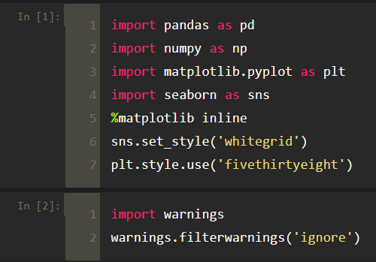
Importing Libraries

Slide 9
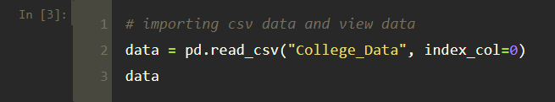
Importing Dataset

Slide 10
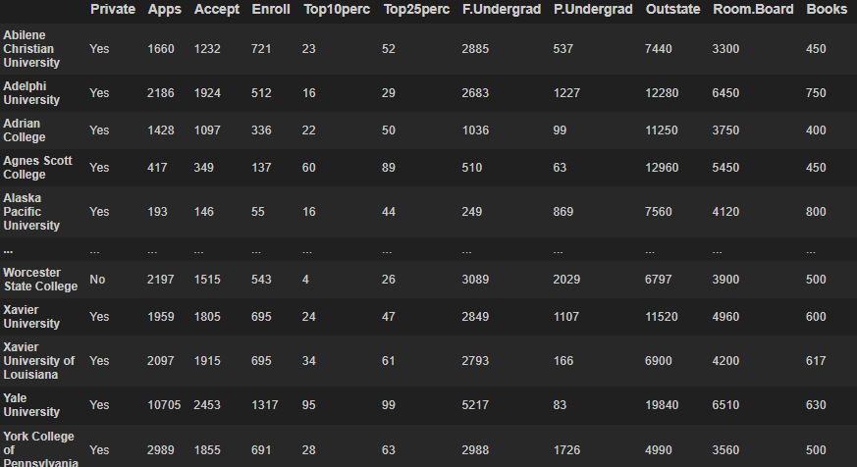
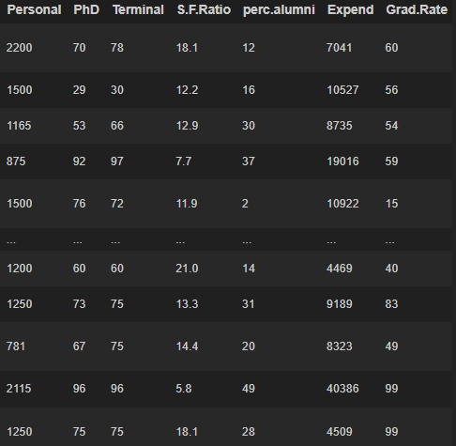

Slide 11
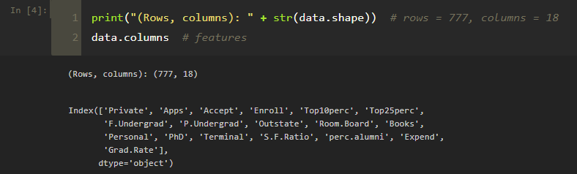

Slide 12
3. Identify the dependent and independent variables.
We don’t have any dependent variable, such problems fall into the category of unsupervised learning
Since we don’t have that frame of reference in unsupervised learning, thus the name
No frame of reference means there is no dependent variable

Slide 13
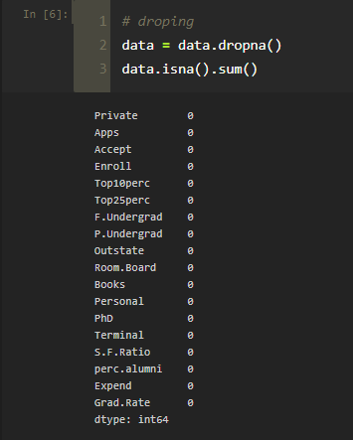
4. Check if the data has missing values or the data is categorical or not.
Dataset has no categorical values
Check for missing/NaN/Null values and drop those columns

Slide 14
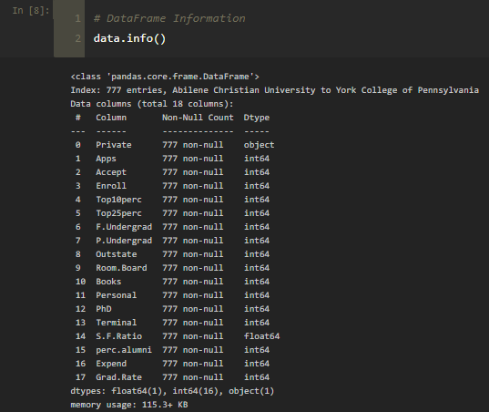
Concise summary of data:

Slide 15
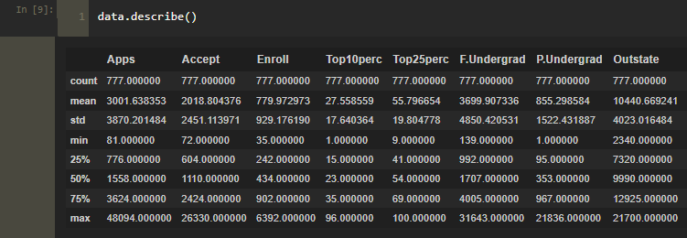
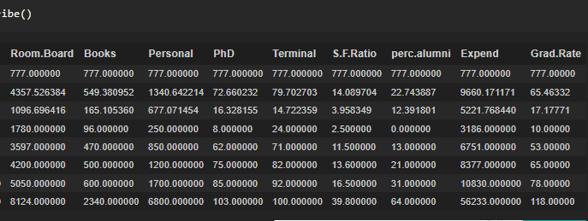
Statistical measures about the data:

Slide 16
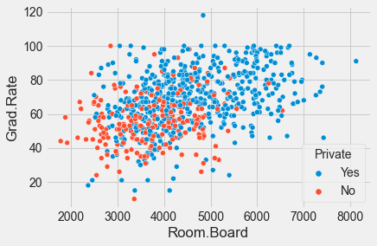

Slide 17
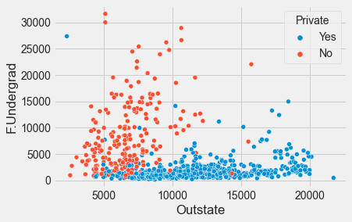

Slide 18
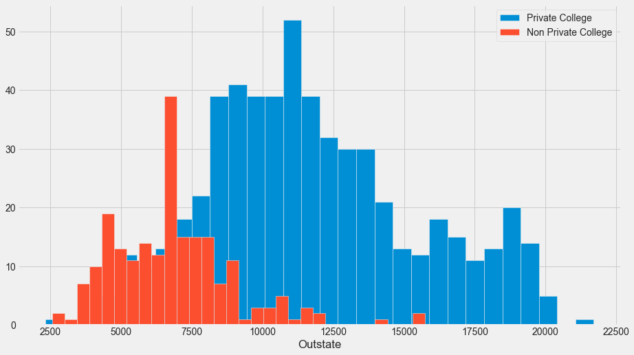
Histogram of Outstate Tuition based on the Private

Slide 19
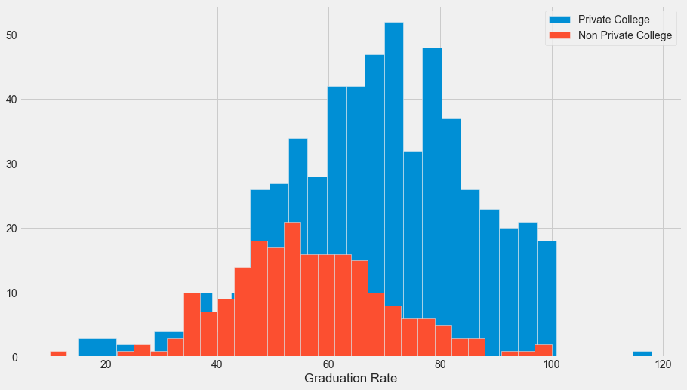
Histogram of Grad.Rate based on the Private

Slide 20
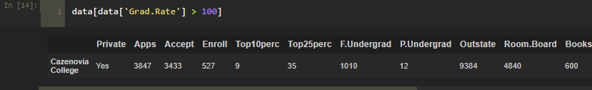
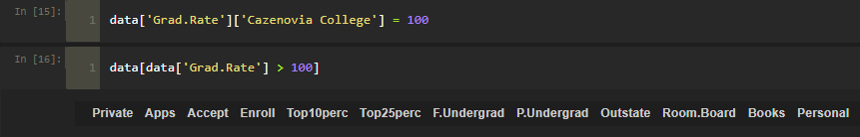
School with a graduation rate of higher than 100%
Notice how there seems to be a private school with a graduation rate of higher than 100%
We need to set that school’s graduation rate to 100% so it makes sense.
Now there is no school with graduation rate higher than 100%

Slide 21
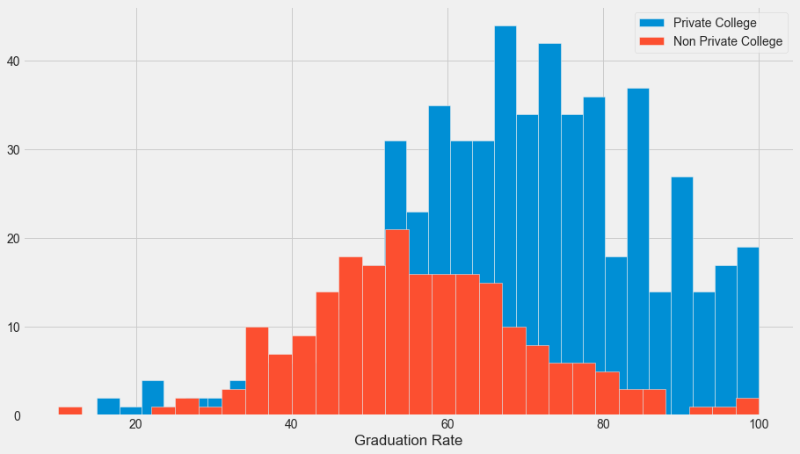
We can see there are no data points that fall outside 100.
No school with graduation rate higher than 100%

Slide 22
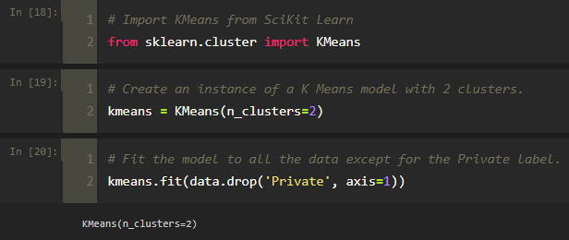
6. Applying K means Clustering

Slide 23
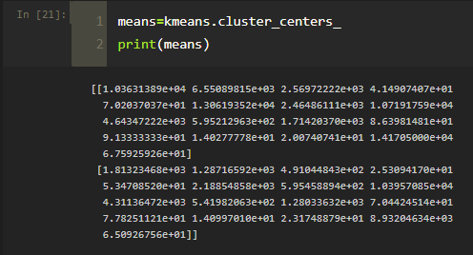

Slide 24
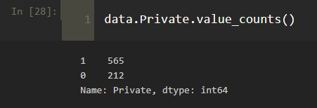
7. Model Evaluation
There is no perfect way to evaluate clustering if we don’t have the labels, however, we do have the labels, so we take advantage of this to evaluate our clusters.
Create a new column for df called ‘Cluster’, which is a 1 for a Private school, and a 0 for a public school.

Slide 25
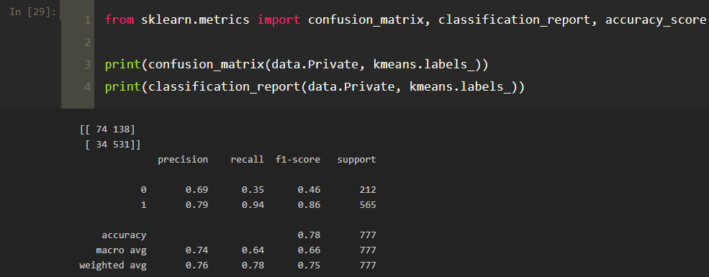
Creating a confusion matrix and classification report to see how well the K means clustering worked without being given any labels.

Slide 26
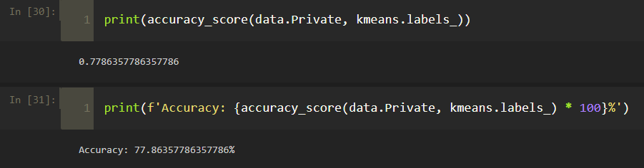
Accuracy: 77.86%

Slide 27
Thank you!
By Mohammed Faraz Hussain
Terna Engineering College, Nerul
ID: TU3F1920077
Roll No.: TE-B-24

